Slide 1
PROJECT PRESS-HUNT CLONE WEBSITE
MADE BY – SARTHAK MUKHERJEE - currently pursuing B.tech Degree from Vit bhopal University
SATWIK MUKHERJEE - currently pursuing B.tech Degree from Vit bhopal University

Slide 2
Requirements to create a website
Html
Css
Javascript
bootstrap
React
Nodejs
DBMS (SQL / My Sql)

Slide 3
Idea for designing this website
The sample website given to take in as a refrence is https://presshunt.co/ , the very first part of creating a website that is similar to the above website is to understand what's given in the website and its key feature.
Now our plan to create a website is very simple the first process is to simply clone the website as it is than make changes accordingly .

Slide 4

Our idea
1--> The idea is to create a website in a similar way to the sample given ,so now the first thing that comes from the refrence given is creating a database for journalists and podcasts which is the most important part .
2--> Creating a easy and attractive user interface for users so that they fully utilise the website to their benefit .
3-->functionality btw the website and sample website will mostly be the same some new modifications in the styling of website as well as changing the content will be made as guided .

Slide 5

Brief explanation of the presshunt website
Press Hunt is a comprehensive journalist database that helps public relations campaign companies.
"Press Hunt saves you hundreds of hours by aggregating data on over 750k journalists, reporters, and podcasts in one place, complete with their coverage focuses and contact info" which means a common platform to find who we need and for what purpose we need to guide us through .
It is the most powerful journalist database on the internet .

Slide 6
Functionality of the website
Some basic functionality that the website deals with are to create the users own id and password for user to login/sign-in or sign-up.
It is a website which deals with a huge no. of journalist around the globe along with large number of podcasts .
This website keeps the user updated to what they like to know about the most and allows them to keep contact with their favorite journalist and to create a list of them and save it.
The journalists & podcasts cover everything from startups and crypto to fashion, art, and photography etc .
The website provides interactive and easy way to connect with user also allows user to give feedback or suggestions.
This database has been used to run PR campaigns for companies.

Slide 7
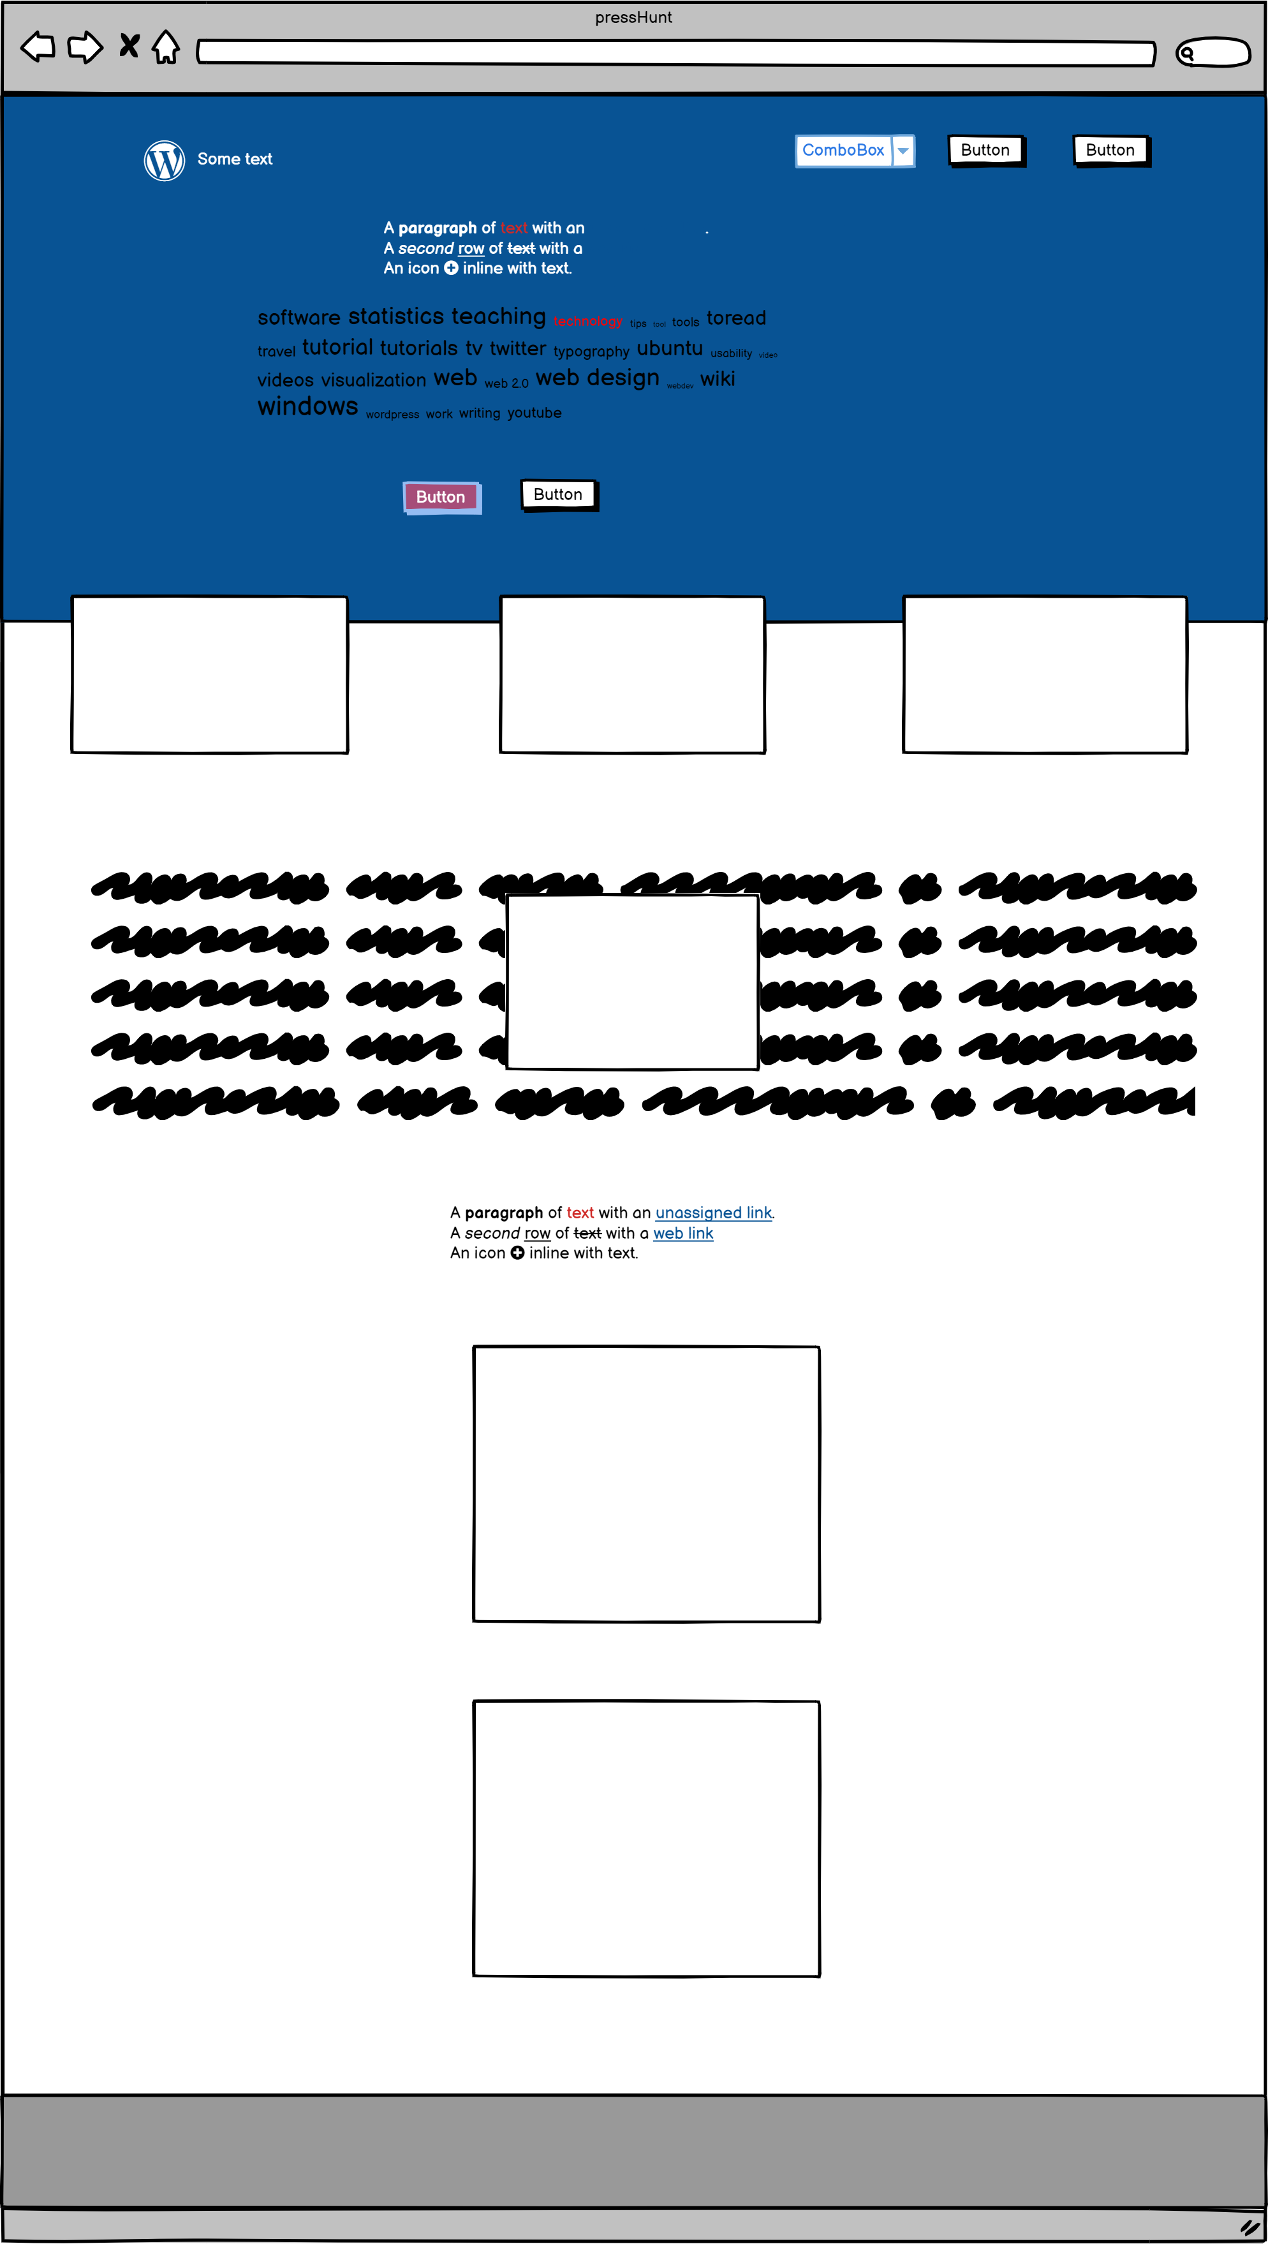
OUR progress
On the right side of this page we can see the wire frame of the website that we will create .
Our first plan in proceeding with the website is to simply coding our website similar to the sample website which has been provided to us.
The coding will be done using simple html,css,javascript at first than we will proceed with modifying the website using frameworks like bootstrap etc .
The final work is of backend which consist of managing the database as well the functionality of the website .

